Slide 1
Constructor
Software Engineering 1B

Slide 2
Constructor
Constructor is a special method that gets invoked “automatically” at the time of object creation.
Constructor is normally used for initializing objects with default values unless different values are supplied.
Constructor has the same name as the class name
Constructor cannot return values.
Types of Constructors
Default Constructor Parametrized Constructor

Slide 3
Default Constructor
Example:
Both x and y will show zero values as constructor sets default values. The default value for number data types (int and double) is zero
Class Demo
{
static void main(String[] args) {
Circle c= new Circle();
System.out.println(“The value of x is “+ c.x);
System.out.println(“The value of y is “+ c.y);
System.out.println(“The value of radius is “+ c.radius);
}
}
Class Circle
{
public double x;
public double y;
public double radius;
public Circle()
{
radius=0;
}
}

Slide 4
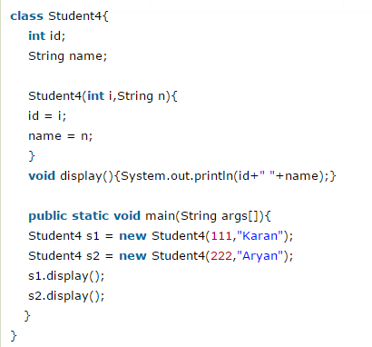
Parametrized Constructor
Why we used parametrized constructor?
Parameterized constructor is used to provide different values to the distinct objects.
Example-1:

Slide 5
Parametrized Constructor
Example-2:
Class Circle
{
public double x;
public double y;
public double radius;
public Circle()
{
radius=0;
}
public Circle (double x, double y, double radius)
{
this.x=x; this.y=y; this.radius=radius;
}
}
Class Demo
{
static void main(String[] args) {
Circle c= new Circle(10,10,20);
System.out.println(“The value of x is “+ c.x);
System.out.println(“The value of y is “+ c.y);
System.out.println(“The value of radius is “+ c.radius);
}
}

Slide 6
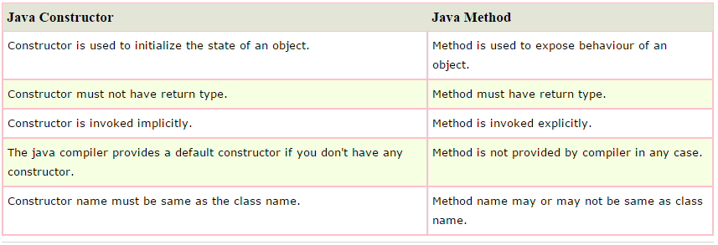
Method vs Constructor

